Slide 1
GROUP 5
PROJECT TOPIC:
CUSTOMER’S SATISFACTION ABOUT SDSU’S DAIRY BAR

Slide 2
Background of SDSU Dairy Bar
The SDSU Dairy bar is an ice cream manufacturing company located in Brookings, South Dakota on the SDSU campus
The SDSU Dairy Bar is also a part of the Brookings Great 8 Passport program which encourages visitors and locals to explore their one-of-a-kind attractions
If you haven’t tried SDSU ice cream yet, it’s time.
It was established in 1910. They have more than 60 Flavors of rich homemade ice cream and sherbet which are served daily and can also be purchased in half gallon containers.
Flavors, such as Pumpkin, are produced seasonally, while others, such as Vanilla, are produced every week.
The top flavors are Vanilla, followed by Cookies ‘n Cream, and then Chocolate.

Slide 3
PROBLEM FORMULATION
Managerial Decision Problem
Marketing Research Problem
Are customers satisfied with the current ice cream flavors?
Is the space, tables and chairs at the Dairy Bar enough for customers?
Are customers aware of the non-dairy products such as cookies, cake, sandwiches and so on that Dairy Bar sells?
examining customer’s satisfaction about the current ice cream flavors
determining how customers feel about the space, table and chairs provided
determining the awareness of customers about the non-dairy products such as cookies, cake, sandwiches and so on

Slide 4
Specific Objectives
determining customer satisfaction about the current ice cream flavors
finding out customer’s awareness about the non-dairy products such as cookies and so on at the Dairy Bar
determining how customer’s feel about the space, tables and chairs provided at the Dairy Bar
examining customer’s satisfaction concerning the pricing of the Dairy Bar as compared to others

Slide 5
Survey Design and Implementation
We choose an in-person survey design for our project.
we believe people are more likely to answer our questionnaire if it is given to them in person.
We choose non probability sampling technique, and specifically, convenience sampling approach, due to time constraint
it is the most efficient way to gather our data for analysis purposes in a timely fashion.

Slide 6
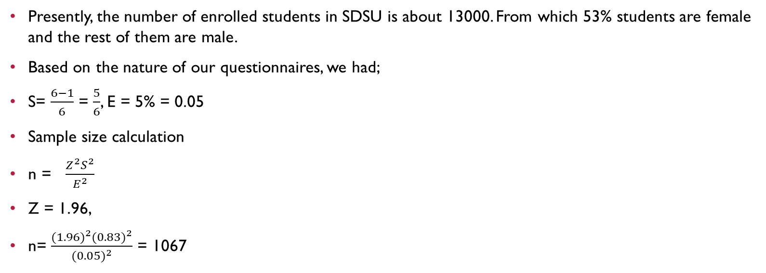
Sample Size Calculations
Presently, the number of enrolled students in SDSU is about 13000. From which 53% students are female and the rest of them are male.
Based on the nature of our questionnaires, we had;
S= $\frac{6−1}{6}$ = $\frac{5}{6}$, E = 5% = 0.05
Sample size calculation
n = $\frac{Z^{2}S^{2}}{E^{2}}$
Z = 1.96,
n= $\frac{{(1.96)}^{2}({0.83)}^{2}}{{(0.05)}^{2}}$ = 1067

Slide 7
Ideal Sample Size
The correction factor is calculated below to aid in the ideal sample size selection
n/N=1067/13000=0.082 >5%, since n/N is larger than 0.05, we do the following calculations
n=1076/ (1+0.082) = 987. Base on this new n, our ideal sample size is 987.
The ideal sample size for our study was 987, but due to time constraint, we worked with 158.

Slide 8
RATIONALE FOR THE CHOICE OF QUESTIONS
Question
RAtionale
Are you aware of the non-dairy products such as cookies, cake, sandwiches and so on at the Dairy Bar?
How satisfied are you with the current ice cream flavors?
How satisfied are you with the ice cream prices at the Dairy Bar?
Managerial decision problem
Due to low patronage
Customers kept asking about new flavors
Complains from customers regarding prices and low patronage

Slide 9
ANALYSIS
Year
We found 49(31%) and 44(27.8%) respondents from sophomores and juniors respectively; these are the highest numbers from any years who participated in our survey.
Among others, 25(15.8%) and 33(20.9%) others are from freshman and seniors respectively and only 5(3.2%) participated from graduate years.
SINGLE VARIABLE ANALYSIS

Slide 10
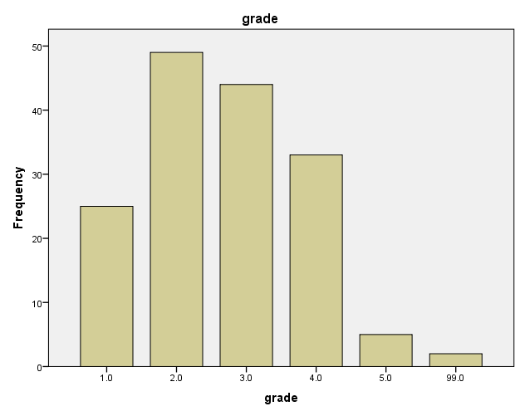
Graph & Statistics

Slide 11
ANALYSIS
Age
Out of the total of 158 respondents, 89 respondents comprising 56.3% belong to the age category 16-20, 61 respondents comprising 38.6% belong the age category 21-25, 7 respondents, comprising 4.4% also have their ages falling within the category 26-30 and only 1 respondent comprising 0.6% has his or her age over 30years.
The bar graph depicting this age category clearly shows that the age group with the highest respondents is 16-20, followed by 21-25 and the least is those above the age 30.
SINGLE VARIABLE ANALYSIS

Slide 12
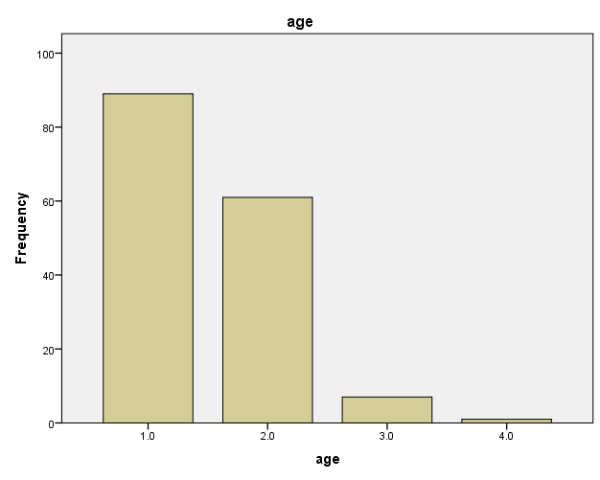
age
 |  | Frequency | Percent | Valid Percent | Cumulative Percent
Valid | 1.0 | 89 | 56.3 | 56.3 | 56.3
 | 2.0 | 61 | 38.6 | 38.6 | 94.9
 | 3.0 | 7 | 4.4 | 4.4 | 99.4
 | 4.0 | 1 | .6 | .6 | 100.0
 | Total | 158 | 100.0 | 100.0

Slide 13
ANALYSIS
Gender
From the gender statistics table, we observe that 54 of our respondents comprising 34.2% were females as against 85 respondents representing 53.8% of male respondents.
We also recoded 18 respondents representing 11.4% who decided not to disclose their gender status to us.
Unfortunately, we had only 1 respondent representing 0.6% who didn’t respond to his or her gender status.
SINGLE VARIABLE ANALYSIS

Slide 14
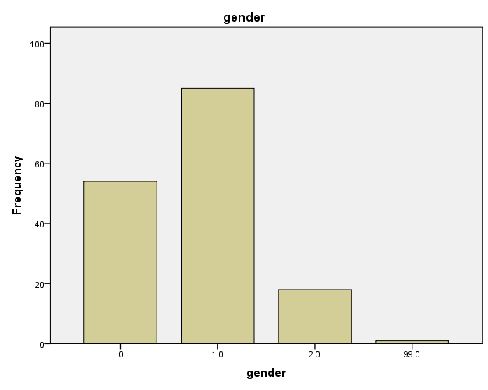
gender
 |  | Frequency | Percent | Valid Percent | Cumulative Percent
Valid | 0.0 | 54 | 34.2 | 34.2 | 34.2
 | 1.0 | 85 | 53.8 | 53.8 | 88.0
 | 2.0 | 18 | 11.4 | 11.4 | 99.4
 | 99.0 | 1 | .6 | .6 | 100.0
 | Total | 158 | 100.0 | 100.0

Slide 15
ANALYSIS
Will you like to order Dairy Bar products online?
Our output shows that 84 respondents representing 53% of customers would not prefer to order Dairy Bar products online and 74 respondents representing 47% of customers would like to order items from the dairy bar online.
Though we had a significant number of respondents who will want to order Dairy products online, we advise that Dairy Bar should not make online ordering available, since those not in favor of this services outweighs those in favor of it.
SINGLE VARIABLE ANALYSIS

Slide 16
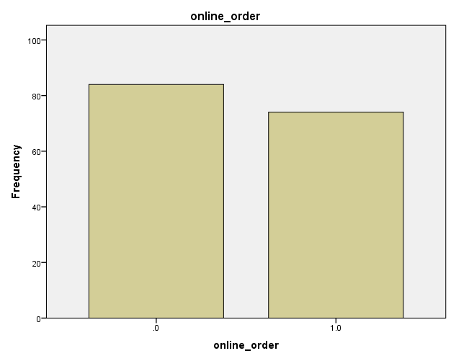
Will you want to order Dairy Bar Product online?
 |  | Frequency | Percent | Valid Percent | Cumulative Percent
Valid | 0.0 | 84 | 53.2 | 53.2 | 53.2
 | 1.0 | 74 | 46.8 | 46.8 | 100.0
 | Total | 158 | 100.0 | 100.0

Slide 17
ANALYSIS
Are you aware of the nondairy products of the Dairy Bar?
The number of respondents saying they were aware is 96 representing 60.8% while the number of respondent saying they were unaware is 62 representing 39.2%.
The bar graph clearly shows the difference between respondent awareness. Majority of the respondents answered that they were aware of the nondairy products of the Dairy Bar.
Although we had 62 respondents representing 39.2% saying they are not aware of the nondairy products, this number is still not negligible.
SINGLE VARIABLE ANALYSIS

Slide 18
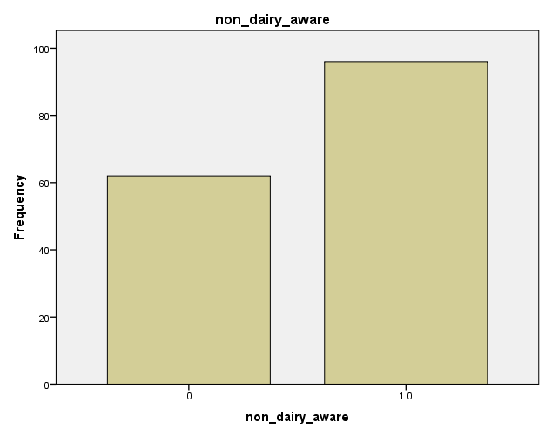
Are you aware of the nondairy products?
 |  | Frequency | Percent | Valid Percent | Cumulative Percent
Valid | 0.0 | 62 | 39.2 | 39.2 | 39.2
 | 1.0 | 96 | 60.8 | 60.8 | 100.0
 | Total | 158 | 100.0 | 100.0

Slide 19
ANALYSIS
What mainly takes you to the Dairy Bar?
Out of 158 respondents, we had 127(80.4%) respondents who goes to the Dairy Bar mainly to buy dairy product, while only 11(7%) respondents visit dairy bar to buy nondairy products.
At the same time 20(12.7%) respondents visit Dairy Bar for other purposes such as to see the different items of dairy and nondairy products, to use internet, to enjoy the environment, to meet with friends etc.
It is an indication that 138(87.3%) respondents visit dairy bar for buying purposes and rest of the respondents go there with non-buying intentions.
Though we had many respondents 62(39.2%) saying that they were aware of the nondairy products, only 11(7%) go there to buy these nondairy products.
SINGLE VARIABLE ANALYSIS

Slide 20
What takes you to the Dairy Bar?
 |  | Frequency | Percent | Valid Percent | Cumulative Percent
Valid | 1.0 | 127 | 80.4 | 80.4 | 80.4
 | 2.0 | 11 | 7.0 | 7.0 | 87.3
 | 3.0 | 20 | 12.7 | 12.7 | 100.0
 | Total | 158 | 100.0 | 100.0

Slide 21
Rationale for specific cross tabs and regressions.
We analyzed some specific variables using crosstabs and regressions just to study the relationship between these variables and how they influence the each other.
Crosstabs were used for variables of categorical in nature.
Regression was used for variables involving ratios and categories.

Slide 22
Crosstabulation analysis

Slide 23
Relationship between what takes a customer to the Dairy Bar and satisfaction level about space
H₀: There is no relationship between satisfaction level about the Space Provided and what takes a respondent to the Dairy Bar
H₁: There is a relationship between the level of satisfaction about Space provided and what takes a respondent to the Dairy Bar
Pearson Chi-Square value is 8.565 with 1 degree of freedom and a prob value of .003 compared with a significance level of 0.05. This prob value 0.003, is much lesser than 0.05.
Hence, we reject the null hypothesis that there is no relationship between space provided and what takes a respondent to the Dairy Bar.
Cramer’s V coefficient is 0.233

Slide 24
Relationship between how often a customer visits the Dairy Bar and their satisfaction with the current ice cream prices.
H₀: There is no relationship between ice cream price satisfaction and how often a respondent visits the Dairy Bar
H₁: There is a relationship between ice cream price satisfaction and how often a respondent visits the Dairy Bar
Pearson Chi-Square value is calculated to be 9.139. The degrees of freedom for the test is 2 and with a prob value of .010 compared with a significance level of 0.05. This prob value .010, is lesser than .05.
Hence, we reject the null hypothesis that there is no relationship between ice cream price satisfaction and how often a respondent visits the Dairy Bar
Cramer’s V coefficient is 0.240

Slide 25
Relationship between how often a customer visits the Dairy Bar and satisfaction level about nondairy products prices
H₀: There is no relationship between how often the customer visits the Dairy Bar and their satisfaction with the prices of the nondairy products.
H₁: There is a relationship between how often the customer visits the Dairy Bar and their satisfaction with the prices of the nondairy products.
Pearson Chi-Square value is 8.630 with 2 degrees of freedom with a probability value of .013 compared with a significance level of .05.
Hence, we reject the null hypothesis that there is no relationship between how often the customer visits the Dairy Bar and their satisfaction with the prices of the nondairy products.
Cramer’s V coefficient is 0. 234

Slide 26
Relationship between satisfaction level about ice cream flavors and what takes a customer to the Dairy Bar
H₀: There is no relationship between how satisfied a customer is with ice cream flavors and what takes a customer to the Dairy Bar
H₁: There is a relationship between how satisfied a customer is with ice cream flavors and what takes a customer to the Dairy Bar
The Pearson Chi Square test is 49.07 with 2 degrees of freedom and a prob value of .000 compared with a significance level of 0.05.
Hence, we reject the null hypothesis that there is no relationship between how satisfied a customer is with ice cream flavors and what takes a customer to the Dairy Bar
Cramer’s V coefficient is 0.557

Slide 27
Relationship between what takes a customer to the Dairy Bar and how satisfied customers are with the customer service
H₀: There is no relationship between what takes a customer to the Dairy Bar and how satisfied customers are with the customer service
H₁: There is a relationship between what takes a customer to the Dairy Bar and how satisfied customers are with the customer service
A Pearson Chi-square value of 10.270 with 2 degrees of freedom and a prob value of .006 compared with a significance level of 0.05.
Hence, we reject the null hypothesis that there is no relationship between what takes a customer to the Dairy Bar and how satisfied customers are with the customer service
Cramer’s V coefficient is 0.255

Slide 28
Relationship between whether a customer purchases nondairy Product and whether they are satisfied with the prices of the nondairy products.
H₀: There is no relationship between whether a customer purchases nondairy Product and whether they are satisfied with the prices of the nondairy products.
H₁: There is a relationship between whether a customer purchases nondairy Product and whether they are satisfied with the prices of the nondairy products.
Pearson Chi-Square value is 7.722 with three degrees of freedom. The probability value of the test is .052.
The value .052 is greater than .05 significance level, so we fail to reject the null hypothesis.
There is no relationship between whether a customer purchases nondairy Product and whether they are satisfied with the prices of the nondairy products.

Slide 29
Relationship between whether a customer purchases ice cream or not and the satisfaction level with the prices of ice cream.
H₀: There is no relationship between whether a customer purchases dairy product or not and the satisfaction level with the prices of the dairy products.
H₁: There is a relationship between whether a customer purchases dairy product or not and the satisfaction level with the prices of the dairy products.
Pearson Chi-Square value is 6.282 with four degrees of freedom and a probability value of .179, which is greater than the significance level of 0.05
so we fail to reject the null hypothesis that there is no relationship between whether a customer purchases dairy product or not and the satisfaction level with the prices of the dairy products.

Slide 30
Discussion of Regression Results

Slide 31
Regression
Goodness of fit, R-squared
In our second model, the R-squared value is 0.164. So, we can say that 16.4% variation in the dependent variable is explained by the independent variables.
ANOVA
We had a probability value of (0.00) (i.e., p = .000), and an F test value of 5.97. This F test is greater than the 0.05 significance level.
Regression Equation and interpretation
Y=1.615 + 0.125X₁+ 0.244X₂ + 0.350X₃ - 0.180X₄ - 0.102X₅
Where; (Y= How likely a customer will visit the Dairy Bar within one month, X₁= How satisfied a customer with the price of ice cream prices at the Dairy Bar, X₂= How satisfied a customer is with the customer services provided at Dairy Bar. How a customer finds out about the Dairy Bar, measured by; X₃= Advertisement, X₄= Through a friend, X₅= Internet)

Slide 32
Regression, cont’d
From this regression, only X₂ (how satisfied a customer is with the customer services provided at Dairy Bar) is significant at a probability value of 0.001
Unfortunately, the remaining variables are not significant

Slide 33
Conclusions and Recommendations
this survey has revealed that over 60% of our respondents knows about the nondairy products of the Dairy bar, yet few customers purchases these products
our single variable analysis revealed that customers though not satisfied with the general prices of the Dairy Bar, they are willing to go there to purchase both ice cream and nondairy products
What this implies is that customers are not price sensitive and hence place premium on customer services from the Dairy Bar
The survey also revealed that although most of the customers are satisfied with the current ice cream flavors, over 40% of our respondents suggested new flavors they will like to purchase or see at the Dairy Bar

Slide 34
Recommendations
Although we have more of our respondents who are aware of the nondairy products of the Dairy, the small numbers must not be overlooked. The Dairy Bar and its management should increase its advertisement and promotions to attract more customers.
The management of the Dairy Bar is advised not to overlook the outcry of customers based on price dissatisfaction, hence price cuts can help attract more customers. But emphasis must be placed on customer service as our respondents placed premium on customer service than on prices.

Slide 35
Limitations and learning experience
Limitations
Time
Resources
Money
professionalism
Learning experience
About SDSU dairy Bar
About marketing research
Using scientific means to study human behaviour

Slide 36
Thank you
Questions?

